Slide 1
Scanning Electron Microscopy with Energy Dispersive Microanalysis VOIDED SOLDER JOINT EVALUATION

Slide 2
Two power diodes were submitted for void analysis. The diodes were soldered to an aluminum clad printed circuit board with tin, silver, copper (SAC) alloy. One diode has been stressed (STRESSED) while the other was not (T0). Both of the mounted diodes were encapsulated in an epoxy resin to allow grinding into the bond line of both diodes. The grinding was achieved with silicon carbide grinding disc in various grit sizes , coarse to fine and then final polished with alumina suspensions. A Thermo Scientific Axia ChemiSEM scanning electron microscope with an integrated Energy Dispersive X-Ray Microanalysis (EDS) Detector was used to collect imaging and materials data for this report.

Slide 3
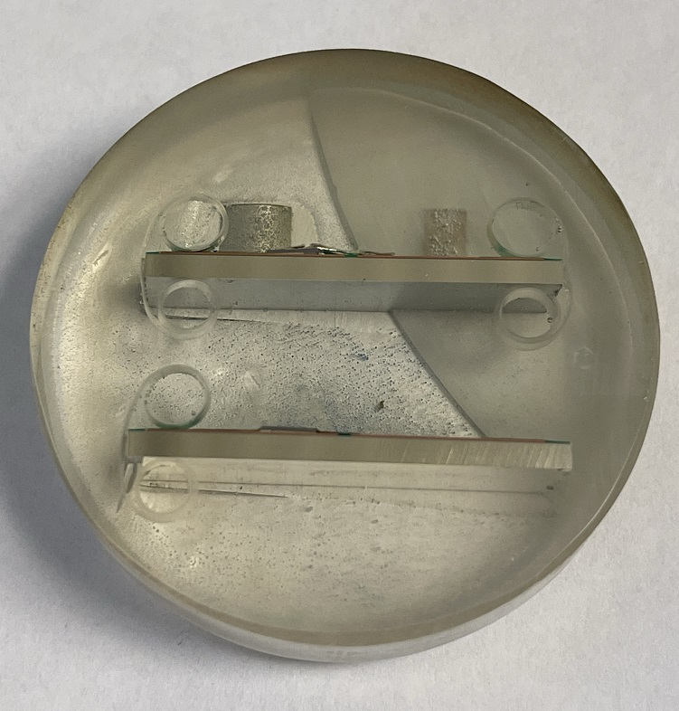
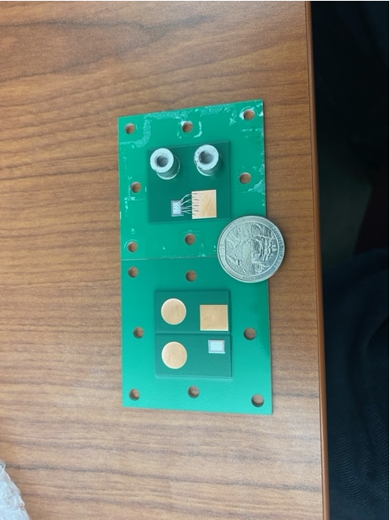
STRESSED
T0

Slide 4
STRESSED DIODE
Aluminum bond wire and wedge bond
Silicon die
SAC alloy solder joint under die
Left side of die bond line thickness
Right side of die bond line thickness, note void at edge.

Slide 5

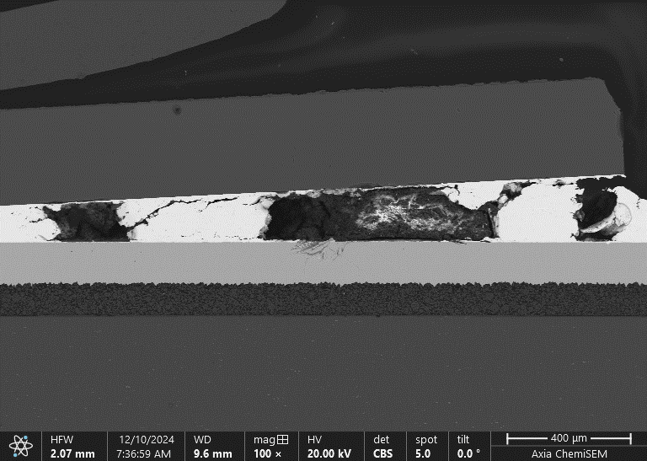
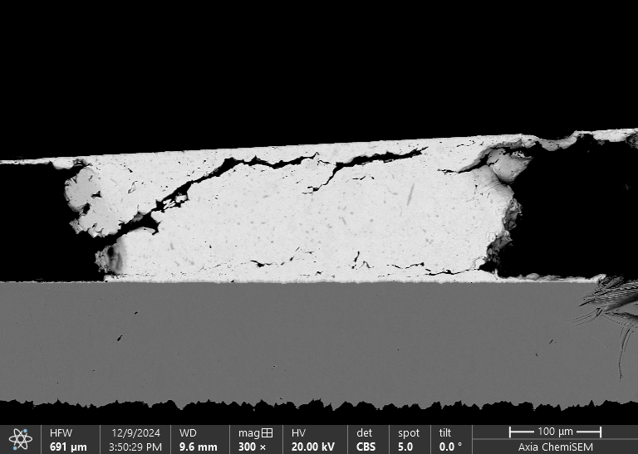
Area 1
Area 2
Right side of die depicting large voids in the bond line thickness.
Right side of die depicting solder joint material Area 1 between large voids in the bond line thickness.

Slide 6
STRESSED DIODE
EDS X-ray mapping of solder joint material Area 1 between large voids in the bond line thickness.

Slide 7
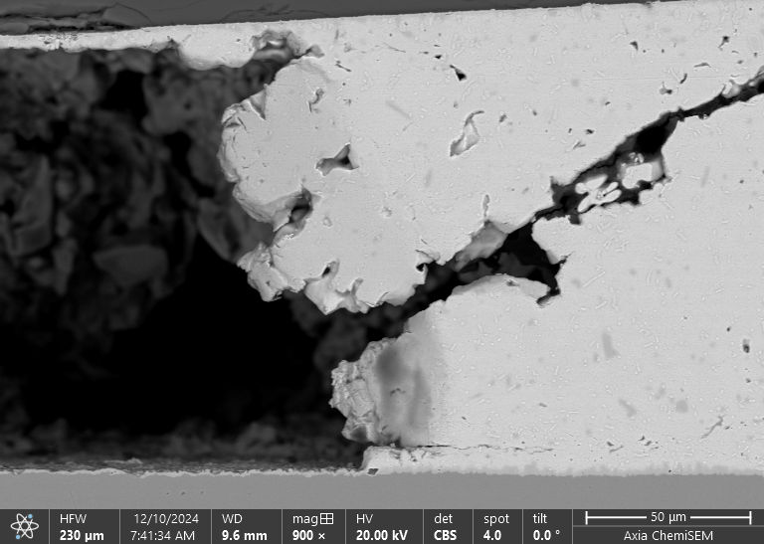
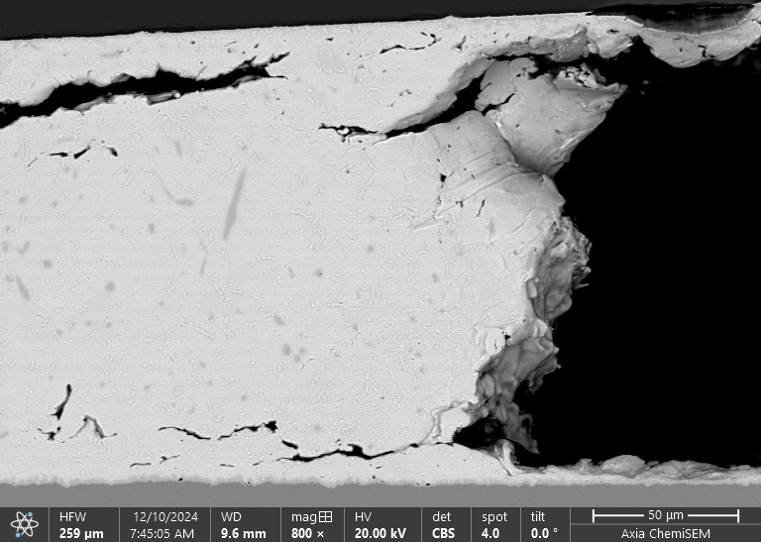
STRESSED DIODE
Backscatter electron images of void walls in Area 1.
Note: Due to lack of support at edge of voids during cross sectioning the walls collapse inwards slightly, marked by dotted lines.

Slide 8
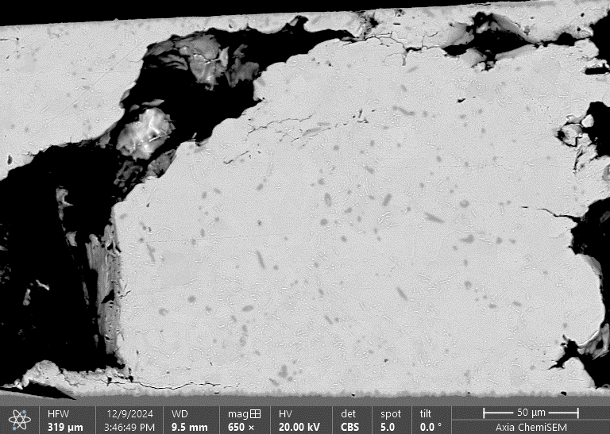
STRESSED DIODE
Right side of die depicting solder joint material Area 2 between large voids in the bond line thickness.

Slide 9
EDS X-ray mapping of solder joint material between large voids Area 2 in the bond line thickness.

Slide 10
STRESSED DIODE
Backscatter electron image of solder joint material left die corner, note cracking.

Slide 11
EDS X-ray mapping of solder joint material left die corner.

Slide 12
CYCLED DIE
Backscatter electron image of typical solder mask to copper interface, no delamination was noted .

Slide 13
EDS X-ray mapping of printed circuit board.

Slide 14
T0 DIE
Silicon die
SAC alloy joint under die
Left side of die bond line thickness
Right side of die bond line thickness.

Slide 15

Area 1
Right side of die depicting voids in the bond line thickness.
Right side of die depicting solder joint material Area 1 between voids in the bond line thickness.

Slide 16
EDS X-ray mapping of solder joint material Area 1 between voids in the bond line thickness.

Slide 17
T0 DIE
Right side of Void 2.
Left side of Void 2

Slide 18
EDS X-ray mapping of solder joint left side Void 2

Slide 19
EDS X-ray mapping of solder joint right side Void 2

